Slide 1

Expense Tracker
Front-End Batch
Name: Pratim Sharma
Under The Guidance:
Miss Jayasuruthy L

Slide 2
introduction
I have Created Express Tracker Using React. Js.
In Which its show your transaction History you can add Your transaction like Salary, purchage and many thing that you buy.

Slide 3
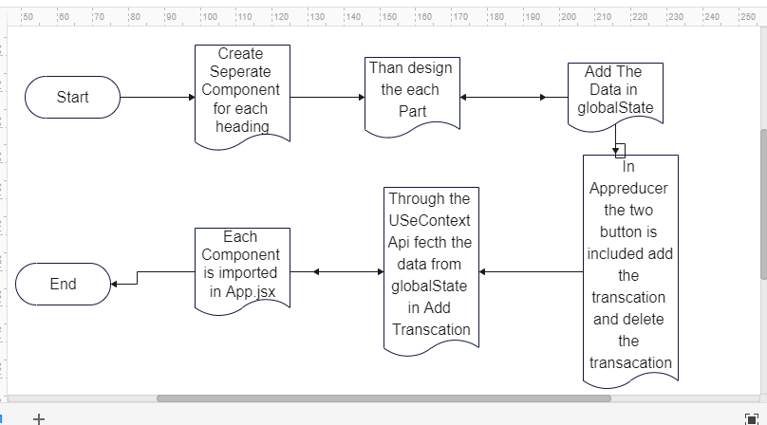

Slide 4
